Slide 1

Phishing Awareness Training
Mrs.Manswi Mohan Patil
Course Name : Cyber security
Date : 20July 2026

Slide 2

What is Phishing ? 1. Phishing is a cyberattack . 2. Attackers pretend to be trusted people or companines . 3. Their goal is to steal passwords , bank details , or personal information .

Slide 3


Types of Phishing ?
Email Phishin
Spear Phishing
Smishing (SMS)
Vishing (Phone Calls)

Slide 4
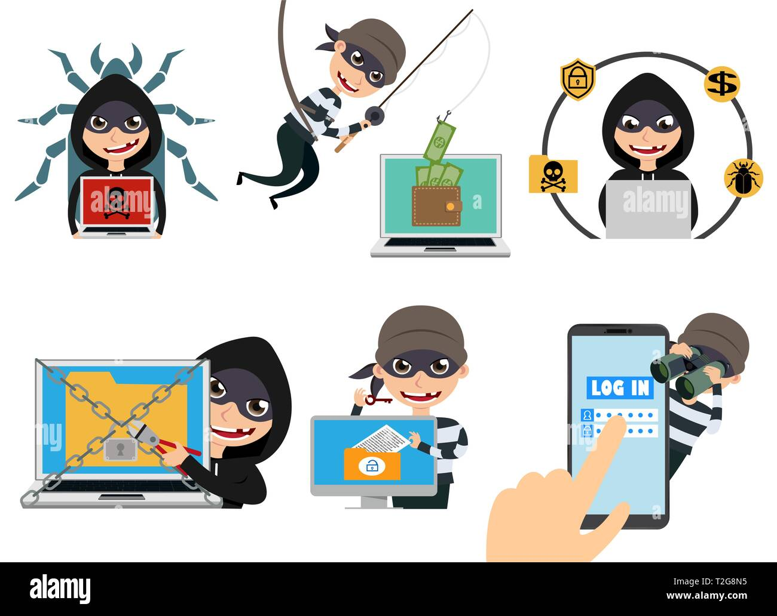
Recognizing Phishing Emails
Unknown sender
Urgent messages
Grammer mistakes
Suspicious links
Unexpected attachments

Slide 5


Identifying Fake Websites
Check the website URL.
Look for HTTPS.
Avoid misspelled website names.
Never enter passwords on suspicious websites

Slide 6
Social Engineering
Pretending to be a bank or company.
Creating urgency.
Asking for passwords or OTPs.
Offering fake prizes.

Slide 7
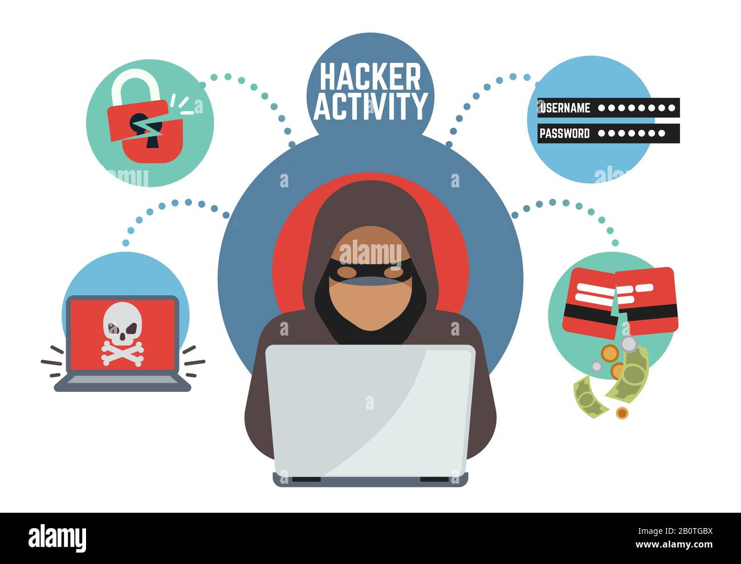
How to Stay Safe
Don’t click unknown links.
Use strong passwords.
Enable Two-Factor Authentication (2FA).
Keep software updated.
Report suspicious emails.

Slide 8
Real –World Example
Content : Email = “Your bank account is blocked. Click here to verify .”
Answer :
Don’t click the link .
Contact the bank directly .
Report the email .

Slide 9
Quiz
Question 1 : What is phishing ?
A. Safe email
B. Fraudulent attempt to steal information
Question 2 : Should you share your OTP ?
A. Yes
B. No

Slide 10
Conclusion
Be alert.
Verify email and websites.
Never share passwords or OTP’s.
Report suspicious messages.

Slide 11
Thank
You

